Slide 1
Introduction to Git Authored & Presented by: Rekha Arjun

Slide 2
Session 1

Slide 3

Agenda
Introduction to VCS
CVCS v/s DVCS
Storage mechanism of VCSs
Brief history of Git
Why Git?
2

Slide 4
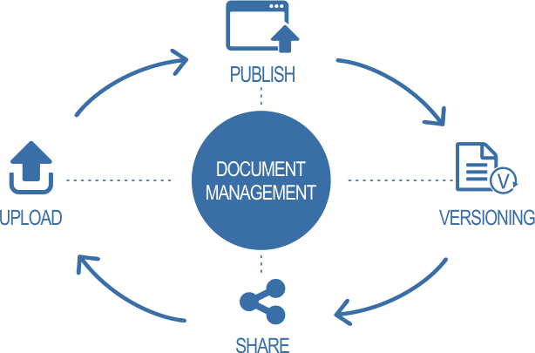
Introduction - Version Control System
Version control is a system that records changes to a file or set of files over time so that you can recall specific versions later.
Every modification to the code is tracked in a special kind of database.
If you screw things up or lose files, developers can turn back the clock and compare earlier versions of the code to help fix the mistake while minimizing disruption to all team members.

Slide 5




Introduction - Version Control System
“Change history” of every file
Traceability
Rollback is easy
Types – DVCS | CVCS

Slide 6
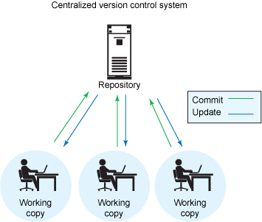
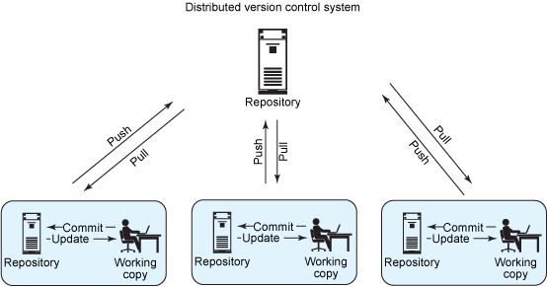
CVCS v/s DVCS

Slide 7
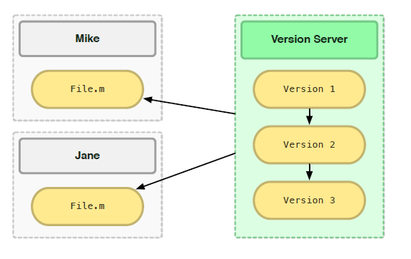
Disadvantages of CVCS
Single point of failure
Dependent on access to the server
Hard to manage a server and backups
It can be slower because every command connects to the server.

Slide 8
Advantages of DVCS over CVCS
Speed : Performing actions other than pushing and pulling change-sets is extremely fast
Local Work : Committing new change-sets can be done locally. Once you have a group of change-sets ready, you can push all of them at once
Reduced Dependency on network connectivity : Everything except pushing and pulling can be done without an internet connection
Clone copy : Each programmer has a full copy of the project repository, thereby contributing to work in active collaboration

Slide 9
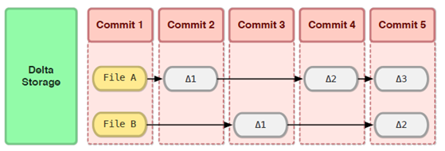
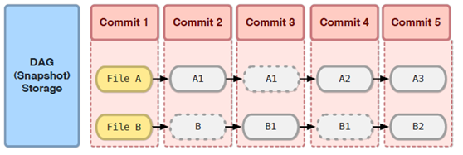
Storage mechanism of VCS
Stores data as changes to a base version of each file
Each commit takes a full snapshot of your entire working directory

Slide 10
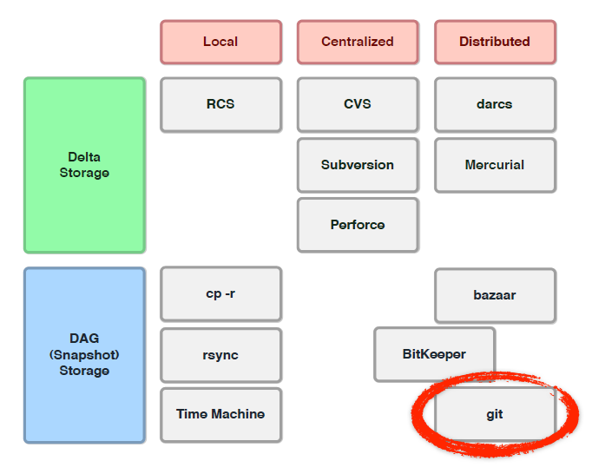
GIT follows DAG
Git is a distributed VCS that uses the snapshot storage model.

Slide 11
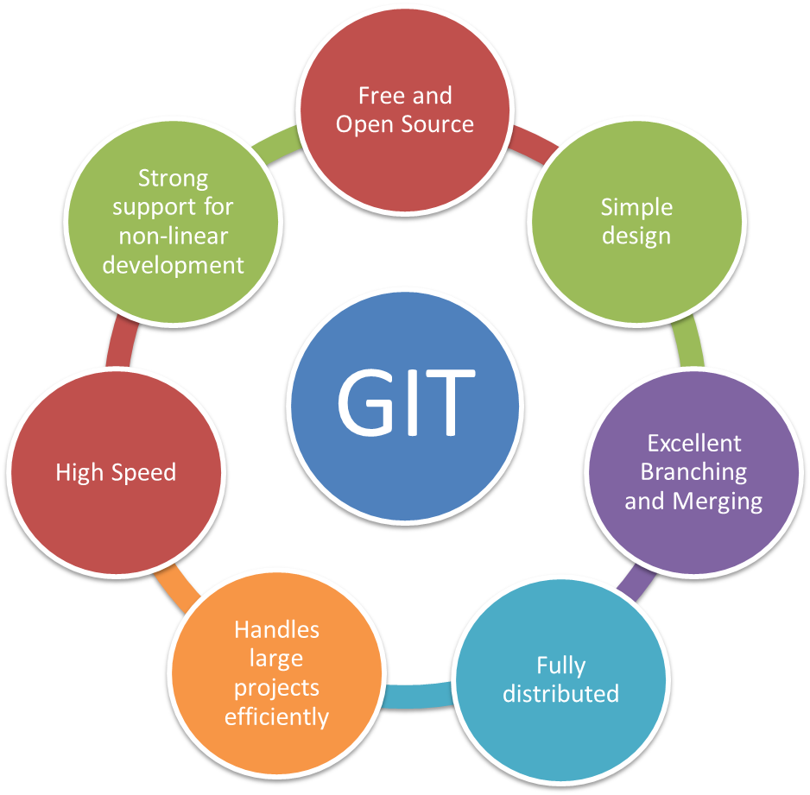
Why GIT?

Slide 12
Brief history of Git
Most widely used in the world
Open source project
Developed in 2005 by Linus Torvalds
Distributed: Working copy is a Repository
Full history of changes
Notes:
By far, the most widely used modern version control system in the world today is Git.
It is a mature, actively maintained open source project originally developed in 2005 by Linus Torvalds.
Having a distributed architecture, every developer's working copy of the code is also a repository that can contain the full history of all changes.
In addition to being distributed, Git has been designed with performance, security and flexibility in mind.

Slide 13
Session 2

Slide 14
Agenda
Git basic workflow (commands)
Git internal workflow
What is Git branch?
Git workflows for branching
Test yourself

Slide 15
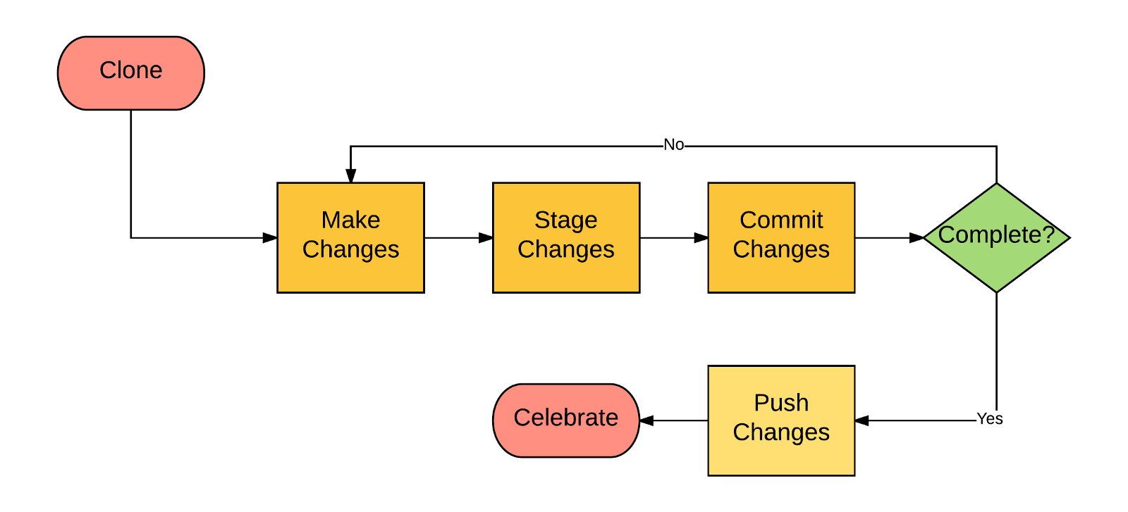
Git Basic Workflow

Slide 16
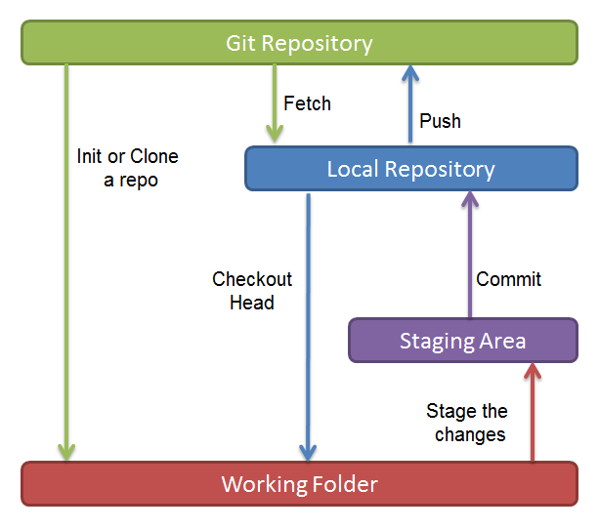
Git commands
git init / git clone <repo url>
git add index.php
git commit –m “first commit”
git pull
git push origin master

Slide 17
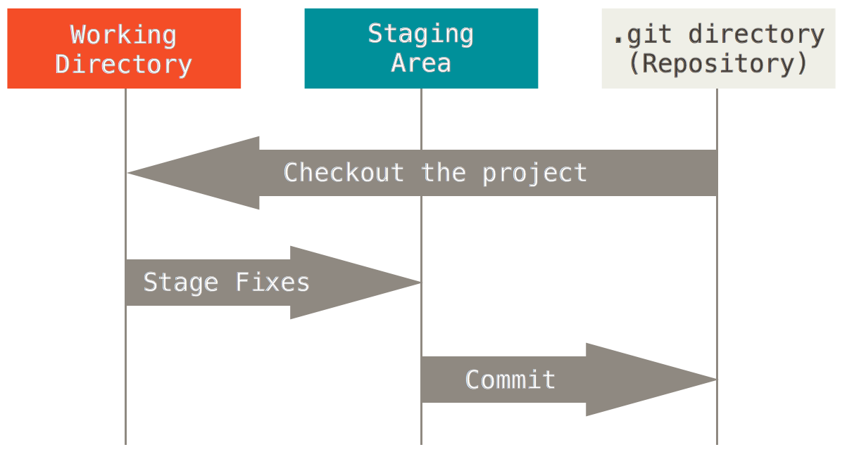
Git internal workflow
This leads us to the three main sections of a Git project
Git Directory: is where Git stores the metadata and object database for your project.
Staging Area: stores information about what will go into your next commit. Also called ‘Index’.
Working directory: is a single checkout of one version of the project
Notes:
Explain two different scenarios here:
Git directory as both local + remote
When explaining as local -> git checkout branch
When explaining as remote -> git clone url
2. Git directory only as local repo

Slide 18
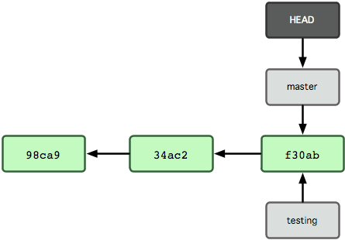
What is Git “branch”?
Movable pointer
Maintains last commit
Not an object
A commit changes its location
Current branch – Check the Head!
Check-out a branch, not commit!

Slide 19

Git Merge
Merge is to join two or more development histories together

Slide 20
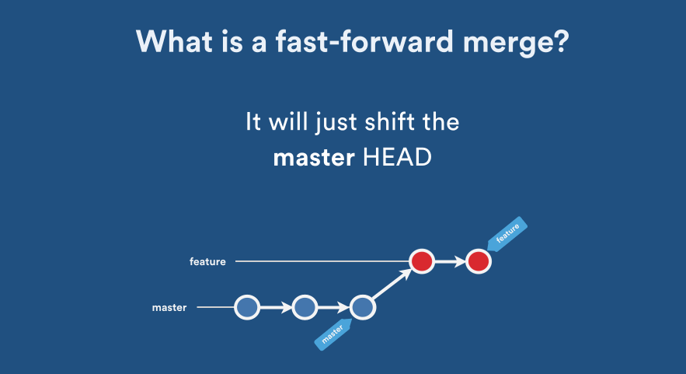
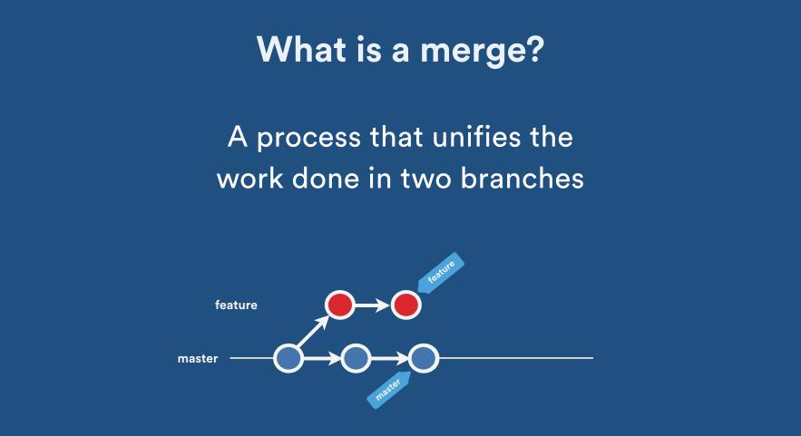
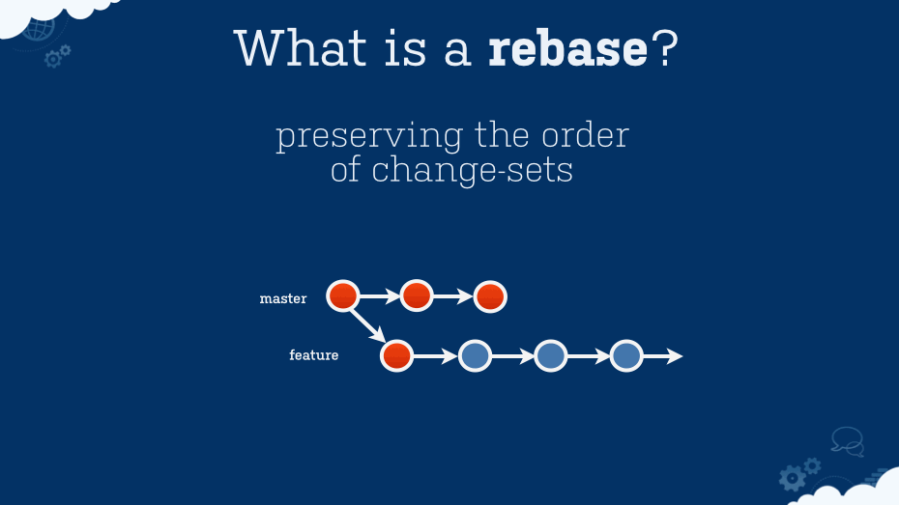
Merging strategies

Slide 21
Git workflows for branching
Centralized Workflow
Feature Branch Workflow
Gitflow Workflow
Forking Workflow

Slide 22
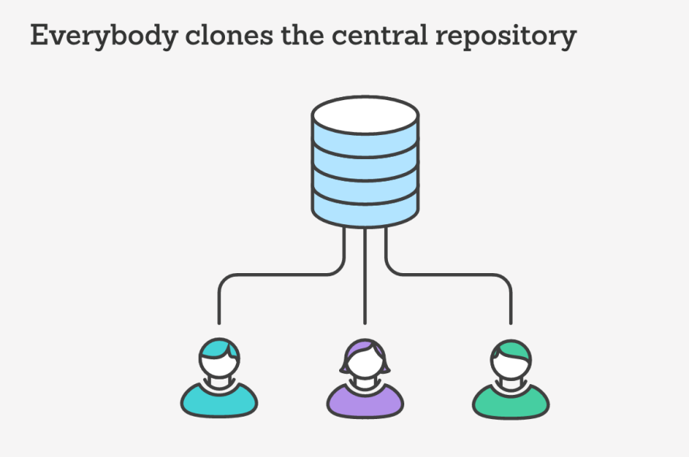
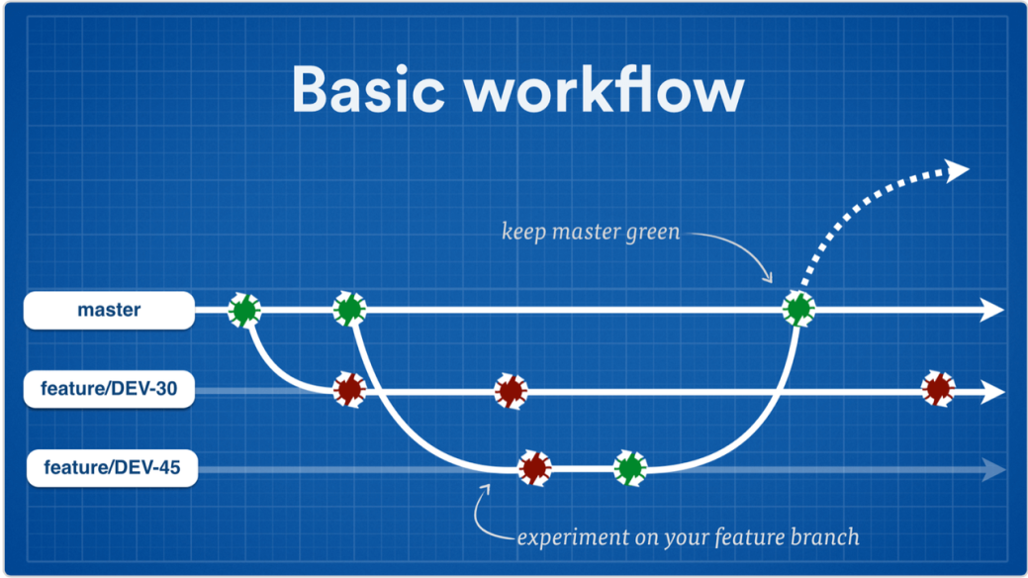
Git workflows for branching
Centralized Workflow
Feature Branch Workflow

Slide 23
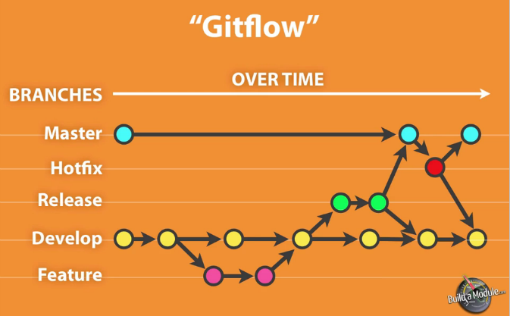
Git workflows for branching
Robust framework for managing larger projects
Assigns specific roles to different branches
Defines how and when they interact
Gitflow Workflow

Slide 24
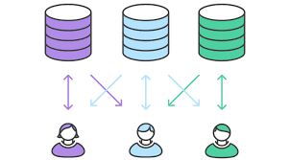
Git workflows for branching
Two repositories for a developer
Encourages open-source work
Ideal workflow for public, open source projects
Forking Workflow
Notes:
Each contributor has not one, but two Git repositories: a private local one and a public server-side one
The main advantage of the Forking Workflow is that contributions can be integrated without the need for everybody to push to a single central repository
This also makes it an ideal workflow for open source projects

Slide 25
DVCS V/S CVCS Revision
Local Clone of Source Code Repository
Reduced Dependency on network connectivity
Single point of failure Solved
Effective Parallel Development
Faster Data Retrieval Snapshot Storage
2
Notes:
Local Clone of Source Code Repository- local copy present so firstly we have a failure recovery mechanism in place, second parallel development made easy for different devs
Reduced Dependency on network connectivity – for all work, we don’t need connection to server, so saves time
Single point of failure Solved – some other workstation can replace the remote server
Effective Parallel Development – reduced merge conflicts because segregated work is done on each developer’s machine rather than continuous conflicts when working in CVCS with continuous connection to remote server
Faster Data Retrieval Snapshot Storage – because snapshot is stored post every commit, extra time to retrieve initial file and club it with delta is not spent. Hence dvcs is faster

Slide 26
Session III

Slide 27
Agenda
Git Object Model
Git Hooks
Best Practices
2

Slide 28
Git Object Model
Types of objects that can represent every type of content in the repository.
Blob – A blob object stores the compressed content of a file, using zlib algorithm
Tree – A tree object stores references of blobs and subtrees with their file modes, types, and file names
Commit – A commit object refers to a tree representing the top-level directory for the commit and parent commits with standard attributes like author, timestamp etc.
Tag – A tag object refers to a commit (or any other object) in repository using a friendly name
2

Slide 29
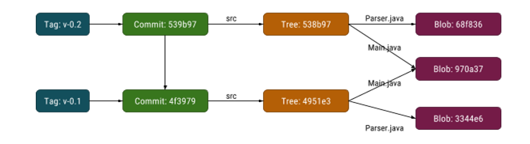
Git Objects
2

Slide 30
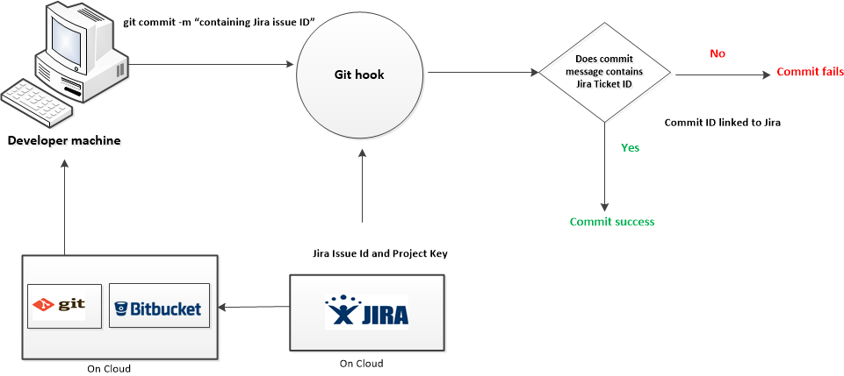
Git hooks
Scripts that run in reaction to specific git events such as commit, push, checkout …
Types of hooks
Client/local side hooks
Server side hooks
Flow of execution
2

Slide 31
Best Practices in Git
Small and Logical Commits
Review your code before committing it.
Never delete Unmerged remote branches.
Never put broken code on the master branch (test first!)
Try not to break things (don't do two weeks worth of work in one commit)
Always use a clear, concise commit message
When making larger changes, consider branches.
Make sure your name and email are right.
2

Slide 32



Slide 33


Slide 34

Thank You!
12/30/2022

